Slide 1
PLACEMENTHUB
The Operating System for Placements, Alumni & Institutional Engagement
PRE-SEED ROUND
Founder: Sandeep Jain
PLACEMENTHUB

Slide 2
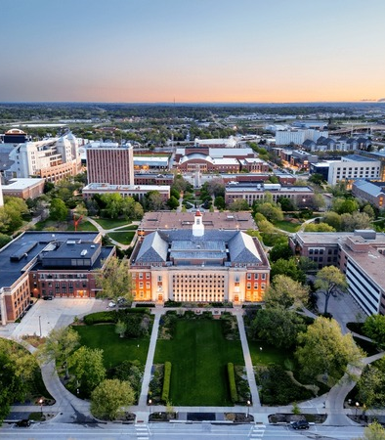
PLACEMENTHUB
Higher Education Engagement is Broken
Placement processes are fragmented across spreadsheets, emails, and legacy tools
Alumni networks remain underutilized — institutions lose touch with graduates within 2 years
Recruiters struggle to identify and reach suitable candidates efficiently
Institutions manage critical placement workflows manually, creating bottlenecks
Students face limited transparency into opportunities, timelines, and outcomes
10M+ graduates produced annually in India — yet placement coordination remains largely analog
02

Slide 3
PLACEMENTHUB
One Platform. Four Stakeholders.
Students
Employers
Institutions
Alumni
Apply, track, and manage placements with full transparency
Discover, assess, and hire the right candidates efficiently
Administer placements, analytics, and compliance in one place
Hire, mentor, and give back to your alma mater
Single Platform For:
Placements — End-to-end placement lifecycle management from posting to offer
Alumni Hiring & Mentoring — Leverage alumni networks for recruitment and student guidance
Scholarships & Sponsorships — Streamlined funding and grant administration
Institutional Engagement — Comprehensive analytics, compliance, and reporting tools
03

Slide 4
PLACEMENTHUB
Key Capabilities
For Students
For Employers
For Institutions
For Alumni
Applications
Placement tracking
Offer management
Interview scheduling
Profile builder
Hiring workflows
Candidate management
Assessments
Job postings
Analytics
Placement administration
Analytics dashboard
Compliance reporting
Student management
Communication tools
Hiring from alma mater
Mentoring students
Scholarship giving
Network access
Event participation
04

Slide 5
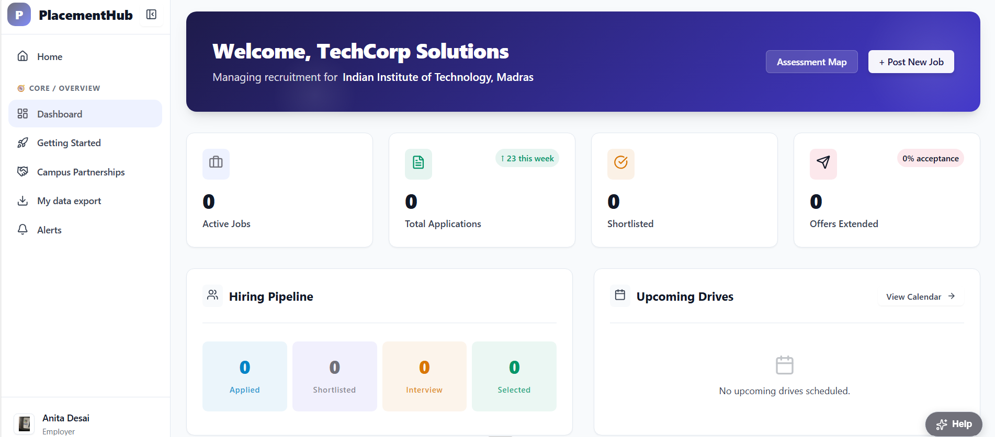
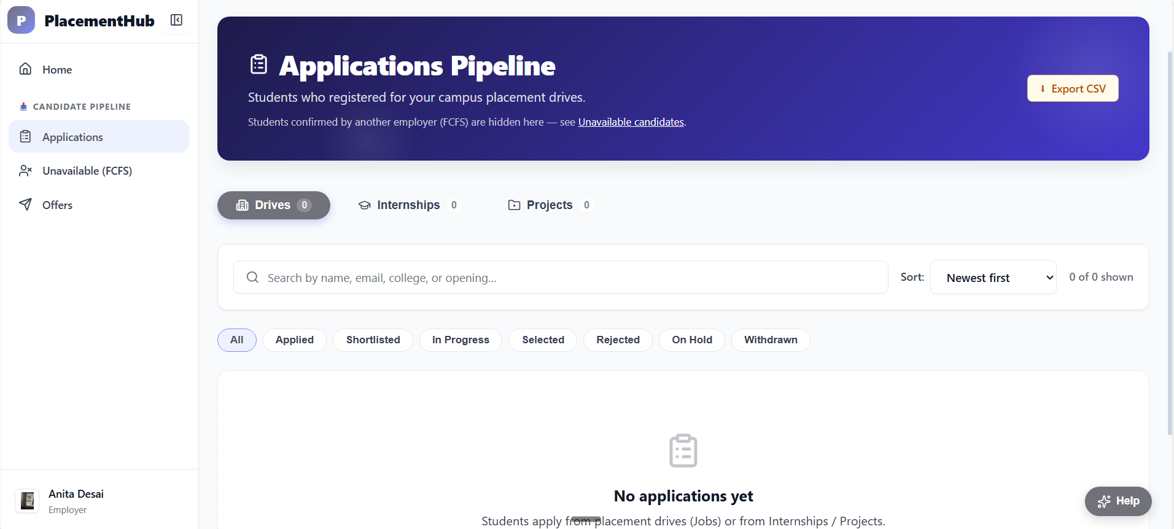
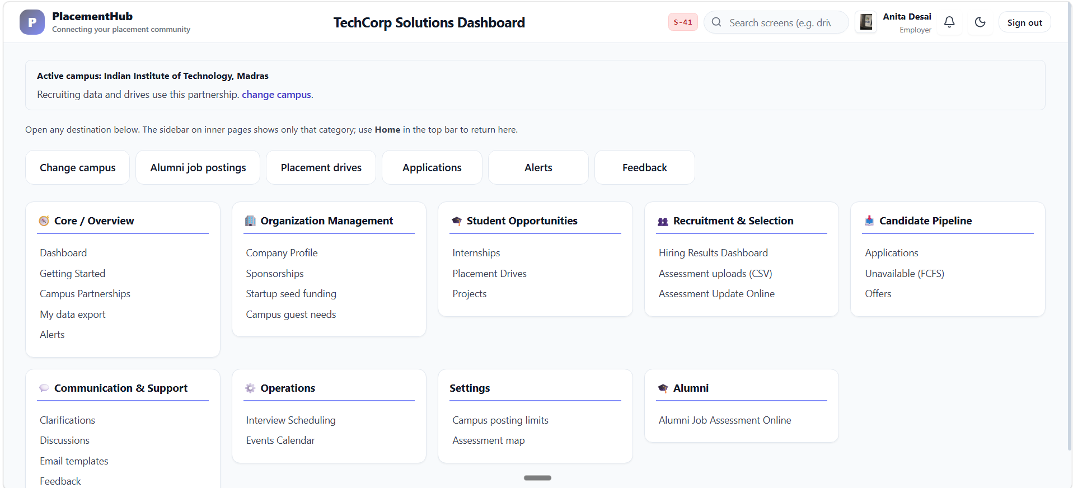
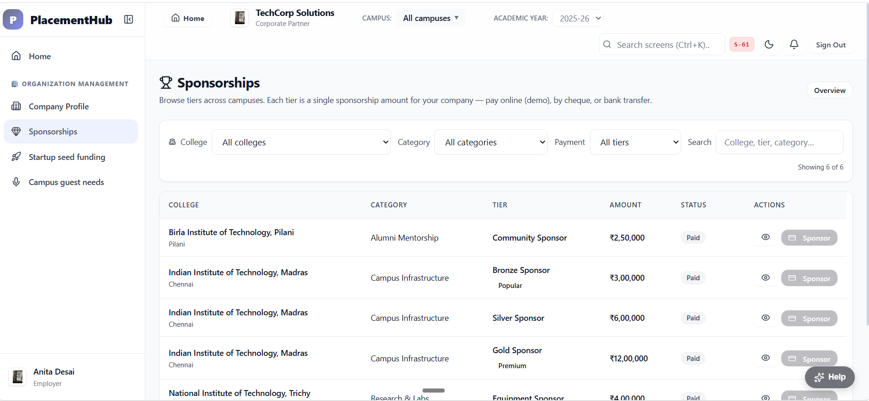
PLACEMENTHUB
Product in Action
Dashboard Overview
Placement Workflow
Employer Portal
Alumni Engagement
05

Slide 6
PLACEMENTHUB
Strong Demand Exists
10M+
NEP
Graduates produced annually in India — a massive, growing talent pool needing structured placement support
2020 mandates robust placement cells — regulatory tailwind driving institutional investment
30%+
3.5x
Of hiring at top institutions now happens through alumni networks — a strategic asset awakening
EdTech adoption growth post-COVID — institutions are actively seeking digital transformation
06

Slide 7
PLACEMENTHUB
Business Model
Multiple revenue streams for sustainable growth
Annual SaaS Subscription
Per-Student Licensing
Premium Employer Access
Recurring revenue from institutions for core platform access
Scalable pricing tied to enrollment — grows with the institution
Featured listings and advanced candidate search for recruiters
Alumni Engagement Modules
White-Label Deployments
Dedicated fundraising and mentorship tools for alumni relations
Custom-branded solutions for large university systems
07

Slide 8
PLACEMENTHUB
Current Progress
Functional platform built — core product ready for deployment
Core workflows validated — placement and alumni modules tested
Cloud deployment completed — live and scalable
Pilot institutions being pursued — active conversations with 3+ premier colleges
Production hardening underway — security audits and performance optimization
08

Slide 9
PLACEMENTHUB
Go-To-Market Strategy
1
Target Premier Institutions
Focus on top-tier colleges with strong placement track records
2
Secure Pilot Deployment
Convert 2-3 pilot institutions in the first 6 months
3
Develop Case Studies
Document measurable outcomes from pilot programs
4
Expand Through Referrals
Leverage institutional networks for organic growth
5
Scale Nationally
Expand to 50+ institutions within 24 months
09

Slide 10
SEED FUNDING ROUND
₹50 Lakh
Use of Funds
Product refinement · Intern support · Institutional outreach
Pilot deployments · Infrastructure
Goal: Secure first institutional deployment and establish commercial traction
PLACEMENTHUB
10

Slide 11
FOUNDER BACKGROUND
30+ years of leadership across staffing, campus engagement, and talent development.
"Experienced leader in staffing, campus engagement, talent development, and large-scale program delivery with 30+ years of industry experience."
Leadership & Experience
Campus & Talent Focus
30+ years of leadership experience across enterprise and startup environments.
Led recruitment, workforce planning, and talent acquisition initiatives across multiple organizations.
Built and mentored high-performing delivery, project, and operations teams in India and international markets.
Successfully scaled teams while maintaining delivery excellence, governance, and operational efficiency.
LinkedIn Profile: https://www.linkedin.com/in/jain35/
Detailed Profile: Summary | Sandeep Jain
Designed and executed campus hiring and internship engagement programs, collaborating with colleges to identify, recruit, and develop early-career talent.
Extensive experience in internship programs, campus hiring, and industry-academia engagement.
Strong focus on employee development, performance management, and leadership coaching.
Combines people leadership, project delivery, and product management expertise to drive organizational growth.
PLACEMENTHUB

